Slide 1
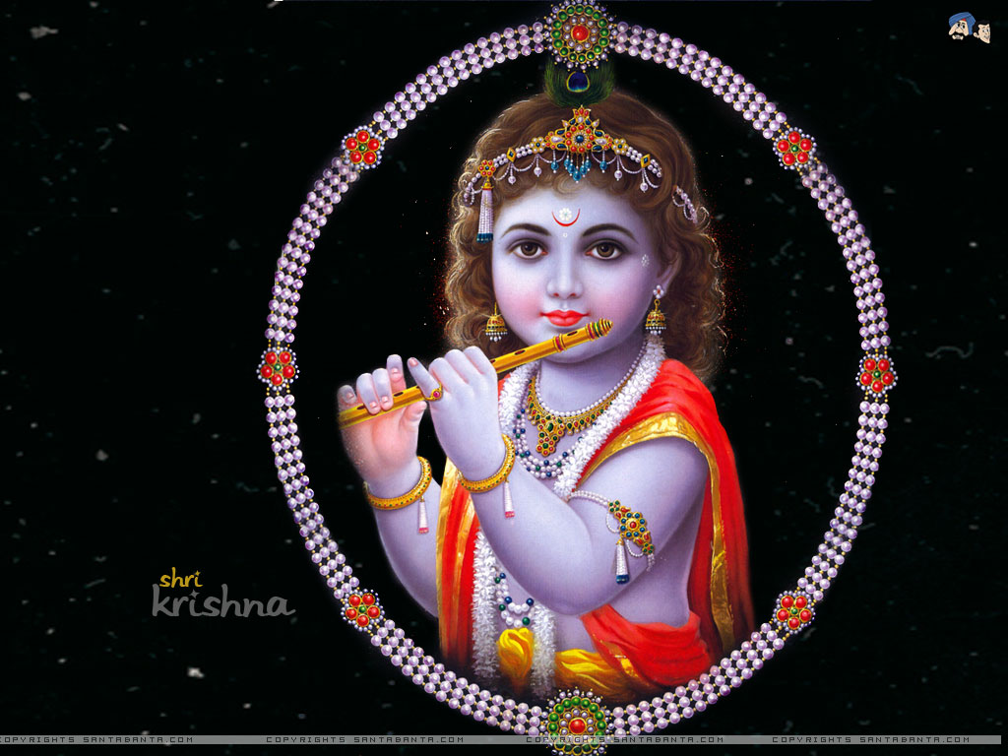
JAI SRI KRISHNA

